Slide 1
Further Games and Graphics Concepts
Week 1 Lecture 1
Intro and Maths Recap

Slide 2
Module Details
Teaching Team
Steve Foster s.foster@staffs.ac.uk
Bob Hobbs r.g.hobbs@staffs.ac.uk
Semester 1 & 2
3 Hours per week
Weeks 1 - 6 (2hrs Lecture + 1hr Tutorial)
Weeks 7 – 12 (1hr Lecture + 2hrs Tutorial)

Slide 3
Module Details
Assignment Details
70% assignment work
Two assignments
Semester 1: 3D Graphics Application
Semester 2: Physics Application
Both submissions have reflective report components
30% Exam
Two hours long
At the end of Semester 2

Slide 4
Program of Study – Semester 1
Week 01 Introduction to Module and Recap
Week 02 Introduction to DirectX API and pipeline
Week 03 Shader Programming Introduction
Week 04 Further Shader Programming
Week 05 Lighting in DirectX
Week 06 Texturing in DirectX
Week 07 Camera Systems and Architecture
Week 08 Cube, Reflection and Bump mapping
Week 09 Mesh Loading
Week 10 Terrain Rendering
Week 11 Environment Rendering and Special Effects
Week 12 Review and Assignment Surgery

Slide 5
Program of Study – Semester 2
Week 01 Animation and Timing
Week 02 Newtonian Physics (velocity, motion, forces)
Week 03 Gravity and friction
Week 04 Particles and Ballistics
Week 05 Rotational Physics
Week 06 Collision Detection and Response
Week 07 Particle Systems
Week 08 Pathfinding and searching, Autonomous motion
Week 09 Ai for scene optimisation
Week 10 State management
Week 11 Decisions and cognition
Week 12 Review and Assignment Surgery

Slide 6
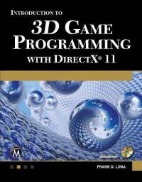
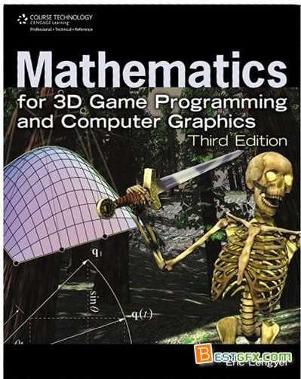
Textbooks – Semester 1 (Core)
Introduction to 3D Game Programming with DirectX 11
Frank Luna
Mathematics for 3D Game Programming and Computer Graphics
Eric Lengyel

Slide 7
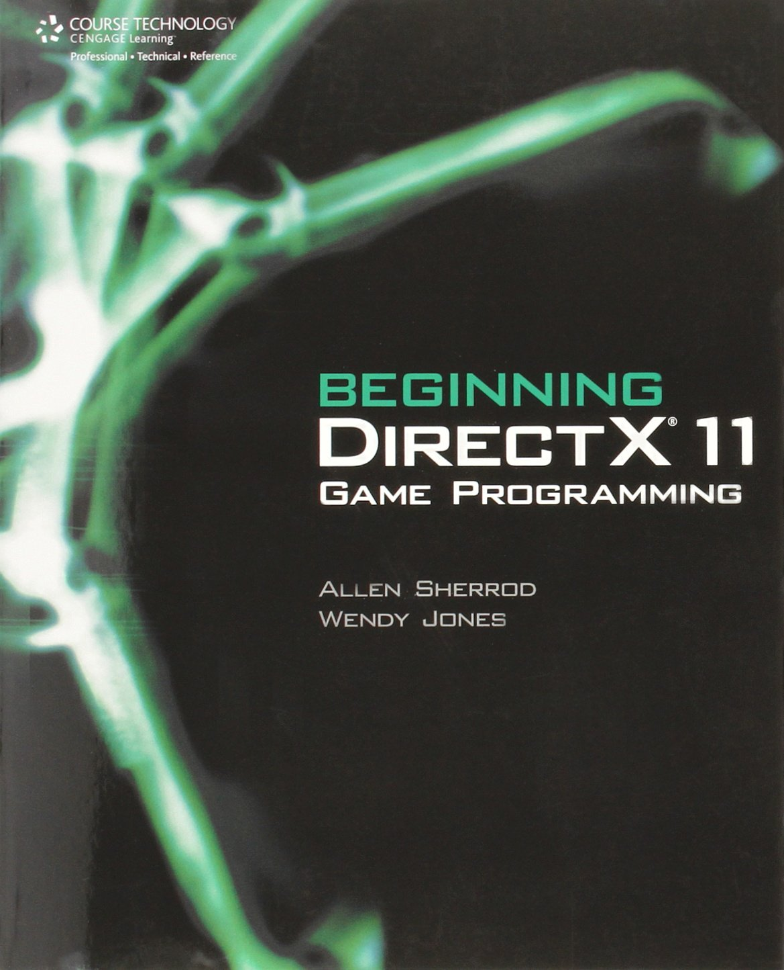
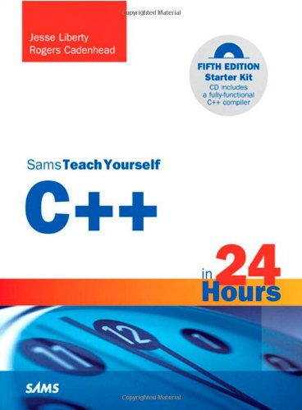
Textbooks – Semester 1 (Optional)
Beginning Directx 11 Game Programming
Wendy Jones
Sams Teach Yourself C++ in 24 Hours
Jesse Liberty

Slide 8
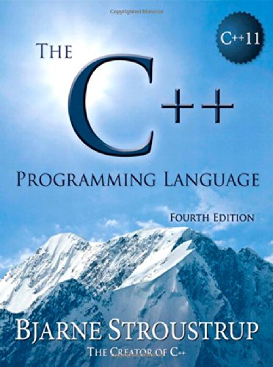
Textbooks – Semester 1 (Optional)
The C++ Programming Language
Bjarne Stroustrup

Slide 9
3D Maths (Quick) Recap
We need two elements available in our 3D space
Points
These are used to define positions
An object is located at a point
A vertex is located at a point
Vectors
These are used to define directions
A viewer is looking in a certain direction
A projectile is moving in a certain direction

Slide 10
Vectors
A vector refers to a quantity that possesses both magnitude and direction
We graphically specify a vector by a directed line segment, where the length denotes its magnitude and the aim denotes its direction
Note that where we draw a vector is immaterial as changing its location does not change its magnitude or direction

Slide 11
Vectors
Computers cannot work with vectors geometrically, therefore we need to represent them numerically
So, in our 3D space we
Define some point as the origin (0, 0, 0)
Assume basis vectors for this 3D space
Translate all vectors so that their tails are at this origin
This is called standard position
We can now represent a vector as the coordinates of its head v = (x, y, z)
Our vector is now defined relative to our 3D coordinate system with origin at (0, 0, 0)

Slide 12
Vectors and Points
Both vectors and points can be described by coordinates (x, y, z) relative to a frame.
However, they are not the same
A point represents a location in 3D-space, whereas a vector represents a magnitude and direction

Slide 13
Vectors
Given points P and Q, we can easily find the vector that lies between them
The vector is Q – P
Note the direction of (Q – P) is from P to Q
Q
Q - P
P

Slide 14
Vectors
Given point P and vector v, we can add these two values together to calculate the point Q
Q = P + v
Q
v
P

Slide 15
Vectors
We can multiply vectors by scalars
If we multiply a vector v by a scalar t we get a vector tv which is
Parallel to v
t times the length of v
v
-1.25 v
1.5 v

Slide 16
Vectors
If we add two vectors together we get another vector as follows
This can be used in a number of situations, for example multiple forces acting on an object
b
a + b
a

Slide 17
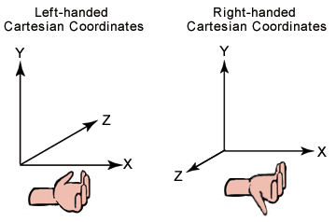
Left-Handed Vs Right-Handed Coordinate Systems
DirectX uses the so-called ‘left-handed coordinate system’
Take your right hand and aim your fingers down the positive x-axis, and then curl your fingers toward the positive y-axis, your thumb points roughly in the direction of the positive z-axis

Slide 18
Vector Operations
We can now define equality, addition, scalar multiplication, and subtraction on vectors using the coordinate representation
Equality
Two vectors are equal if and only if their corresponding components are equal
Let u = (u_{x}, u_{y}, u_{z}) and v = (v_{x}, v_{y}, v_{z})
Then u = v if and only if u_{x} = v_{x}, u_{y} = v_{y}, and u_{z} = v_{z}

Slide 19
Vector Operations
Addition
We add vectors componentwise; as such, it only makes sense to add vectors of the same dimension
E.g. We cannot add a 2D vector and a 3D vector together
Let u = (u_{x}, u_{y}, u_{z}) and v = (v_{x}, v_{y}, v_{z})
Then u + v = (u_{x} + v_{x}, u_{y} + v_{y}, u_{z} + v_{z})
Multiplication
We can multiply a scalar (i.e. a real number) and a vector, and the result is a vector
Let k be a scalar, and let u = (u_{x}, u_{y}, u_{z})
Then ku = (ku_{x}, ku_{y}, ku_{z})

Slide 20
Magnitude
Geometrically, the magnitude of a vector is the length of the directed line segment
We denote the magnitude of a vector by double vertical bars (e.g. ||u|| denotes the magnitude of u)
Now, given a vector v = (x, y, z), we wish to compute its magnitude algebraically
||u|| = √(x² + y² + z²)
This uses Pythagorean Theorem
Note that magnitude is a scalar value

Slide 21
Normalization of Vectors
For some applications, we do not care about the length of a vector because we want to use the vector to represent a pure direction
For such direction-only vectors, we want the length of the vector to be exactly one
When we make a vector unit length, we say that we are normalizing the vector
We can normalize a vector by dividing each of its components by its magnitude

Slide 22
Dot Product
The dot product is a form of vector multiplication that results in a scalar value
Let u = (u_{x}, u_{y}, u_{z}) and v = (v_{x}, v_{y}, v_{z})
The dot product is defined as follows
u • v = u_{x}v_{x} + u_{y}v_{y} + u_{z}v_{z}

Slide 23
Dot Product
The dot product has a number of uses, mostly to do with the angle between two vectors
u•v = ||u|| * ||v|| * cosθ
This says that the dot product between two vectors is the cosine of the angle between them scaled by their magnitudes
In particular, if both u and v are unit vectors, then u•v is the cosine of the angle between them
u•v = cosθ

Slide 24
Dot Product
This provides us with some useful geometric properties of the dot product:
If u•v = 0, then the vectors are perpendicular
If u•v > 0, then the angle between the two vectors is less than 90°
If u•v < 0, then the angle between the two vectors is greater than 90°

Slide 25
Cross Product
Unlike the dot product, which evaluates to a scalar, the cross product evaluates to another vector
The cross product is only defined for 3D vectors
Taking the cross product of two 3D vectors u and v yields another vector, w that is mutually orthogonal to u and v

Slide 26
Cross Product
Let u = (u_{x}, u_{y}, u_{z}) and v = (v_{x}, v_{y}, v_{z})
The cross product is
u ✕ v = (u_{y}v_{z} - u_{z}v_{y}, u_{z}v_{x} - u_{x}v_{z}, u_{x}v_{y} - u_{y}v_{x})
Note that: u ✕ v ≠ v ✕ u

Slide 27
Vectors in Direct3D 11
In D3D 9 and 10 the D3DX library came with a 3D maths library
D3D11 has the DirectXMath library instead
Takes advantage of hardware registers on PC/Xbox 360/Xbox One
In windows the library uses 128-bit wide single instruction multiple data (SIMD) registers
Operates on 4 32-bit floats or ints with one instruction

Slide 28
Vectors in Direct3D 11
Consider vector addition:
u + v = (u_{x} + v_{x}, u_{y} + v_{y}, u_{z} + v_{z})
Using SIMD we can do 4D vector addition with one instruction, instead of 4 scalar instructions
Working in 3D or 2D we just set the extra components to 0
Reduces the number of instructions if used correctly

Slide 29
Vector Types
DirectXMath’s core vector type is XMVECTOR
Maps directly to SIMD registers
Vectors must be of this type to take advantage of SIMD
However, it is recommended to use
XMFLOAT2 (2D)
XMFLOAT3 (3D)
XMFLOAT4 (4D)
Defined as normal structs, need converting to XMVECTOR for operations

Slide 30
Loading and storing vectors
There are a number of included methods to convert from/to XMVECTOR
XMVECTOR XMLoadFloat3(CONST XMFLOAT3 *pSource)
VOID XMStoreFloat3(XMFLOAT3 *pDestination, FXMVECTOR V)
The library includes a number of useful functions
XMVector3Length
XMVector3Dot
XMVector3Cross
XMVector3Normalize
So to summarize, store vectors as XMFLOAT3 and operate on them as XMVECTOR

Slide 31
Reading
Introduction to 3D Game Programming with DirectX 11
Frank Luna
Chapter 1 : Vector Algebra
Mathematics for 3D Game Programming and Computer Graphics
Eric Lengyel
Chapter 1 : Vectors

